Slide 1

ANÁLISIS DE DATOS ESPACIALES
EDIER V. ARISTIZÁBAL G.
Ing. Geólogo (Universidad Nacional de Colombia)
Esp. en Gestión de Riesgos Geológicos (Universidad de Ginebra – Suiza)
MSc. en Geociencias (Universidad de Shimane – Japón)
PhD. en Ingeniería (Universidad Nacional de Colombia)
Universidad Nacional de Colombia
Facultad de Minas
Departamento de Geociencias

Slide 2
All models are wrong, but some are useful.
George Box

Slide 3

MACHINE LEARNING
“A computer program is said to learn from experience E with respect to some class of tasks T and performance measure P, if its performance at tasks in T, as measured by P, improves with experience E.”

Slide 4
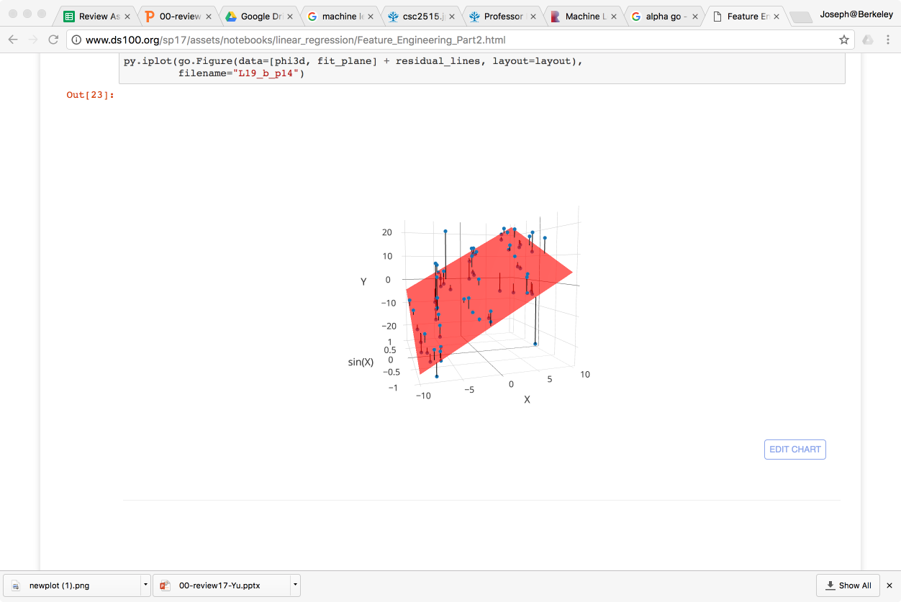
Taxonomy of Machine Learning
Labeled Data
Unlabeled Data
Supervised Learning
Reinforcement
Learning
(not covered)
Unsupervised
Learning
Quantitative Response
Categorical Response
Dimensionality Reduction
Clustering
Regression
Classification
Alpha Go

Slide 5
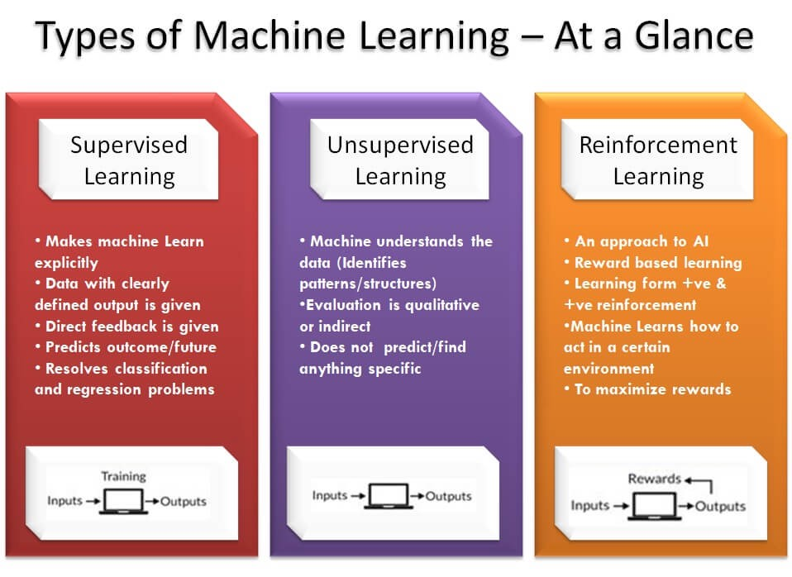

Slide 6
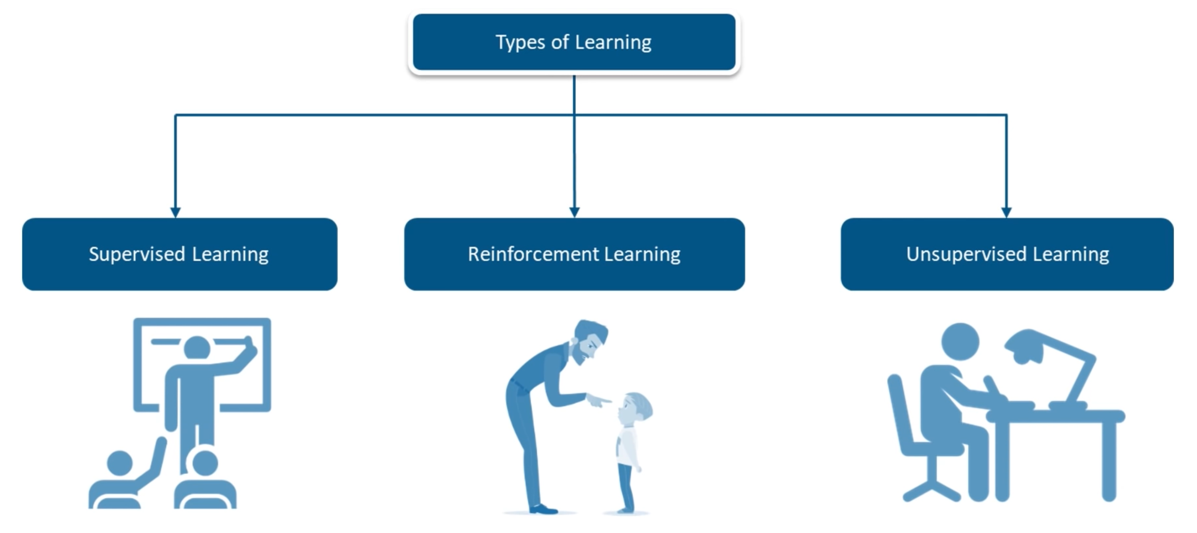
MACHINE LEARNING
x

Slide 7
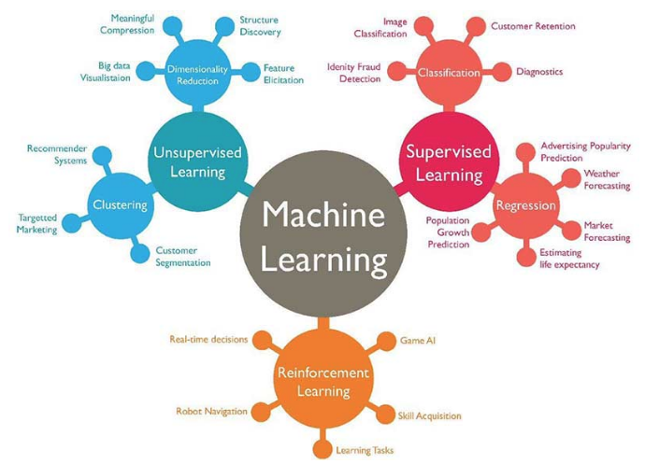
MACHINE LEARNING

Slide 8
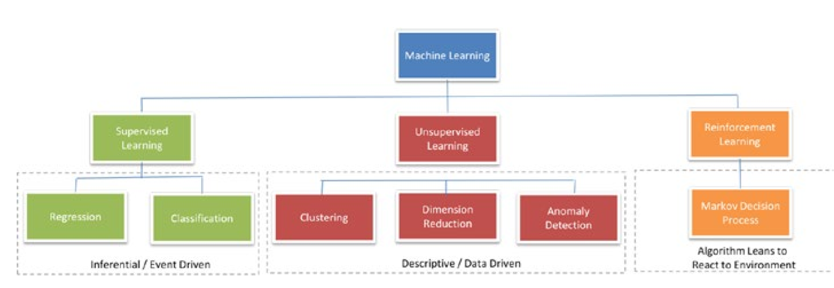
MACHINE LEARNING

Slide 9
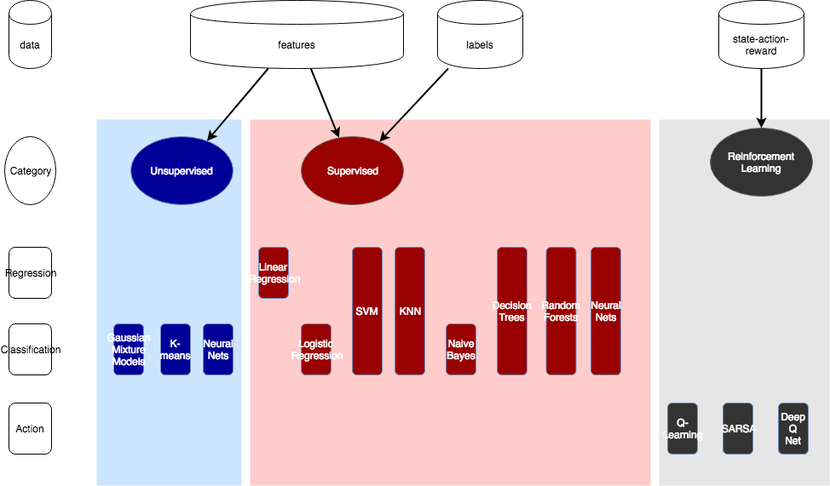
MACHINE LEARNING

Slide 10
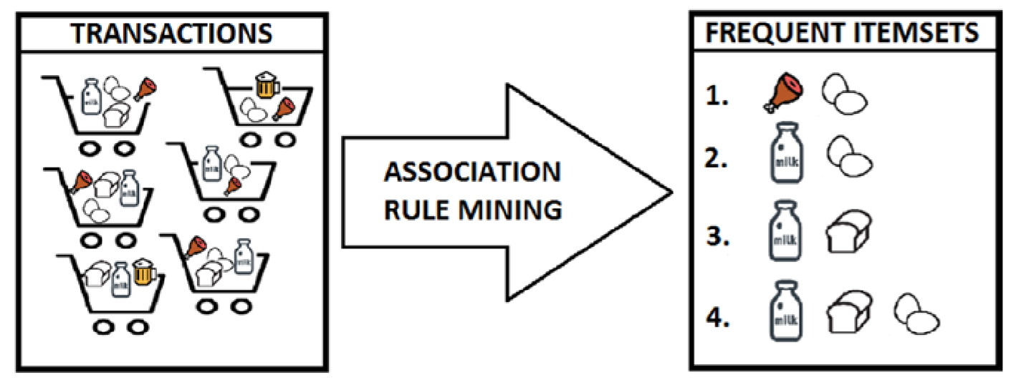
MACHINE LEARNING

Slide 11
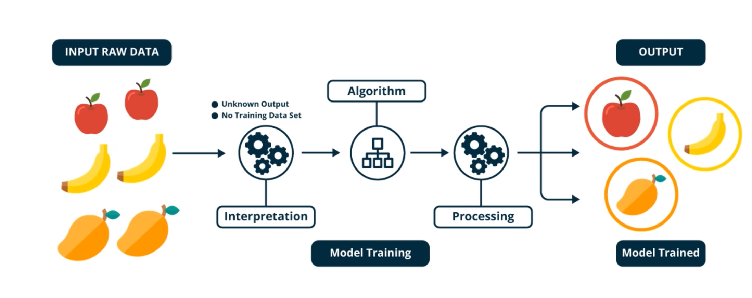
MODELOS NO SUPERVISADOS

Slide 12
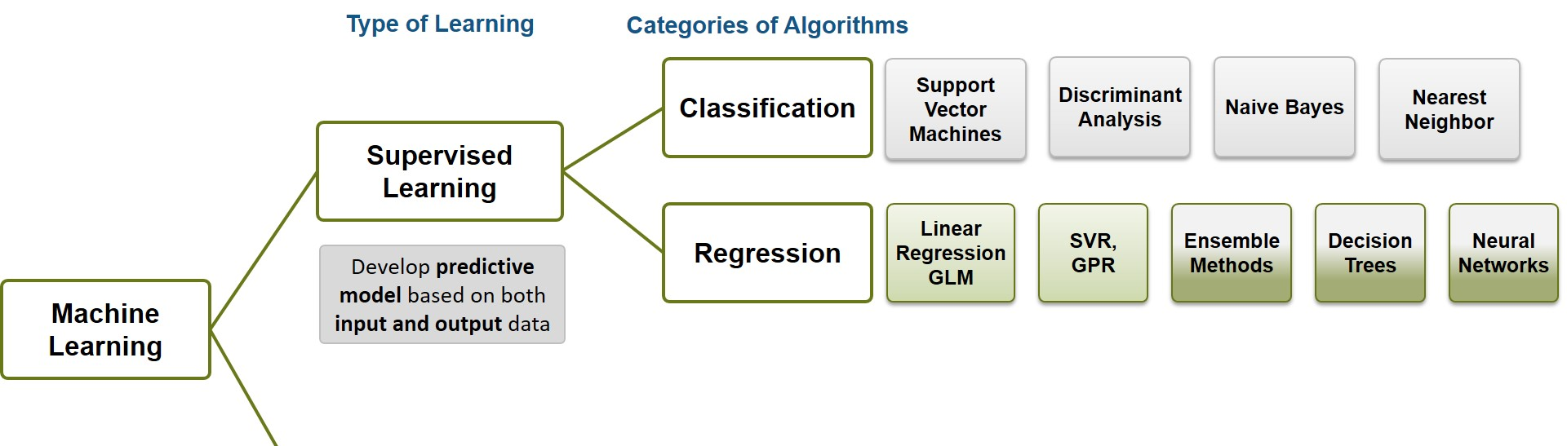
MODELOS SUPERVISADOS
Classification: A classification problem is when the output variable is a category, such as red or blue or disease and no disease.
Regression: A regression problem is when the output variable is a real value, such as dollars or weight

Slide 13
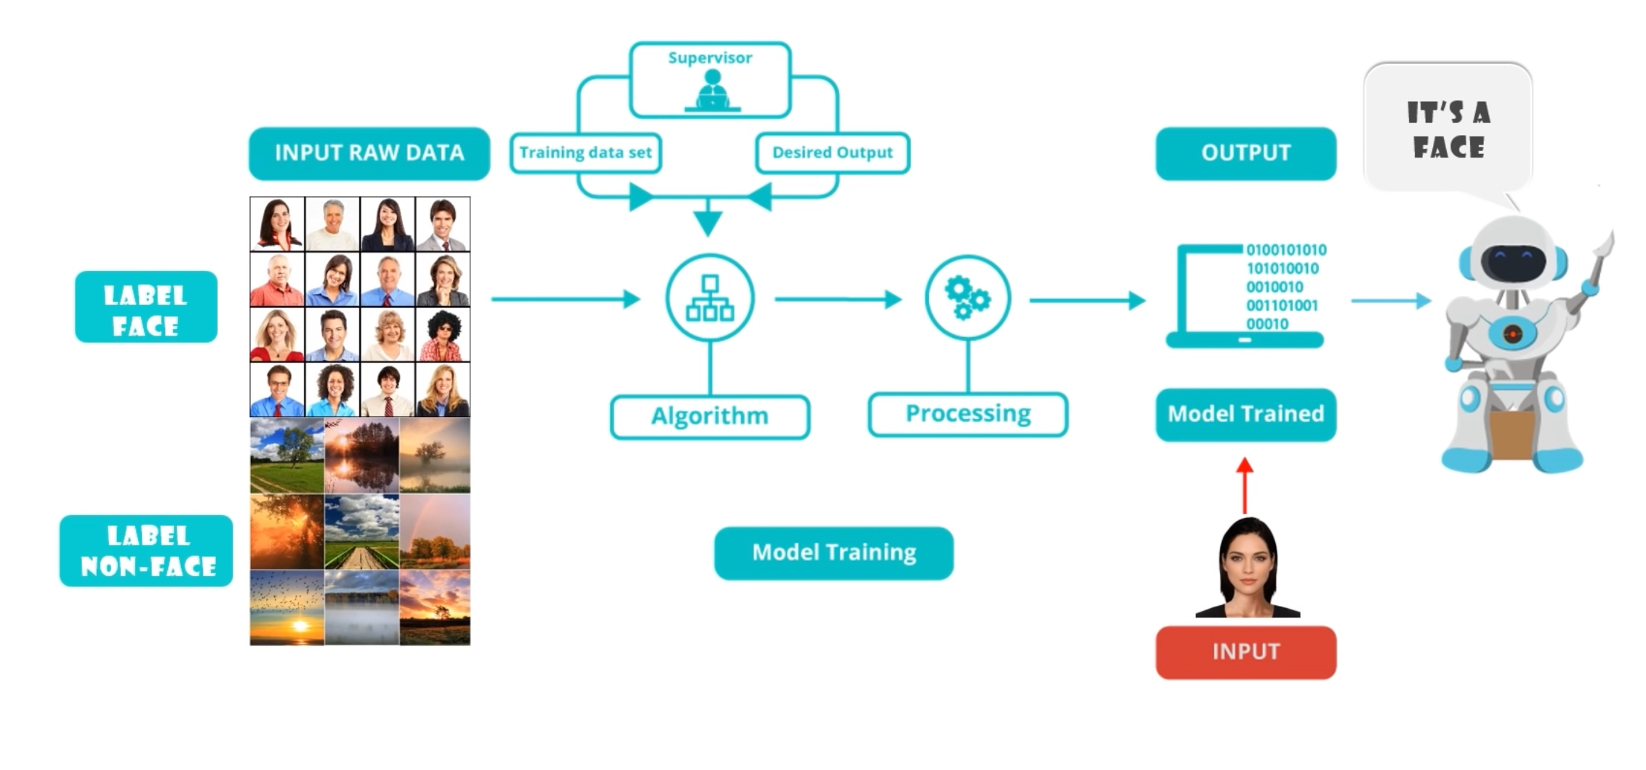
MODELOS SUPERVISADOS

Slide 14
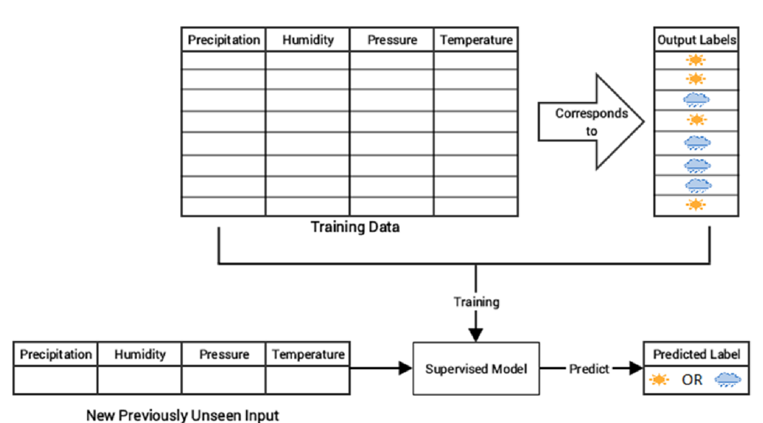
MODELOS SUPERVISADOS

Slide 15
MODELOS PARAMÉTRICOS
Logistic regression, linear discriminant analysis
Algorithms that simplify the function to a known form. Parametric methods involve a two-step model-based approach.
1. Select a form for the function (f).
2. Learn the coefficients for the function from the training data.
Pro:
 Simpler: These methods are easier to understand and interpret results.
 Speed: Parametric models are very fast to learn from data.
 Less Data: They do not require as much training data and can work well even if the data is not perfect.
Con:
 Constrained: By choosing a functional form these methods are highly constrained to the specified form.
 Limited Complexity: The methods are more suited to simpler problems.
 Poor Fit: In practice the methods are unlikely to match the underlying mapping function.
Parametric or linear machine learning algorithms often have a high bias but a low variance.

Slide 16
MODELOS NO PARAMÉTRICOS
Non-parametric models: k-nearest neighbors, decision trees, and random forests, neural network, support vector machine.
Do not have a model structure specified a priori. Instead, the model structure is purely determined from the data. Do not make strong assumptions about the form of the mapping function. By not making assumptions, they are free to learn any functional form from the training data. Non-parametric methods are good when you have a lot of data and no prior knowledge, and when you don't want to worry too much about choosing just the right features.
Pro:
 Flexibility: Capable of fitting a large number of functional forms.
 Power: No assumptions (or weak assumptions) about the underlying function.
 Performance: Can result in higher performance models for prediction.
Con:
 More data: Require a lot more training data to estimate the mapping function.
 Slower: A lot slower to train as they often have far more parameters to train.
 Overfitting: overfitting the training data.
Nonparametric or nonlinear machine learning algorithms often have a low bias but a high variance.

Slide 17
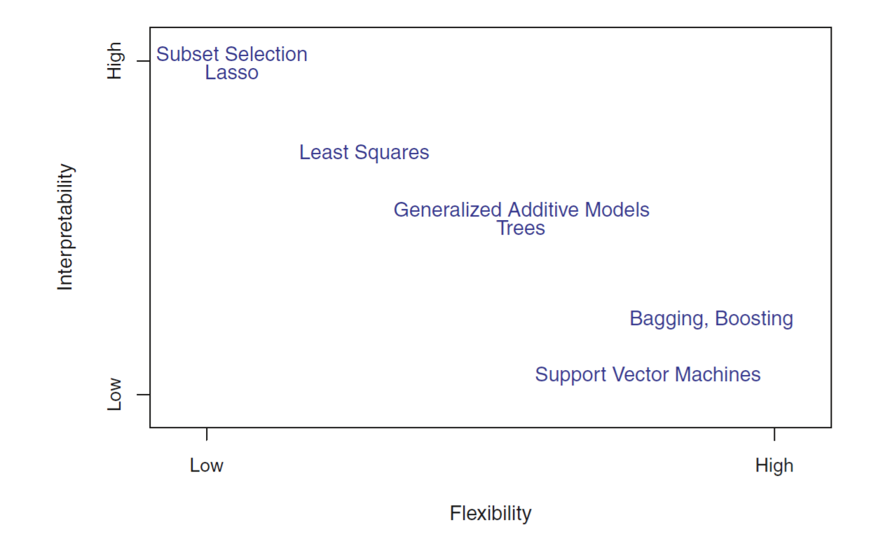
TIPOS DE MODELOS

Slide 18
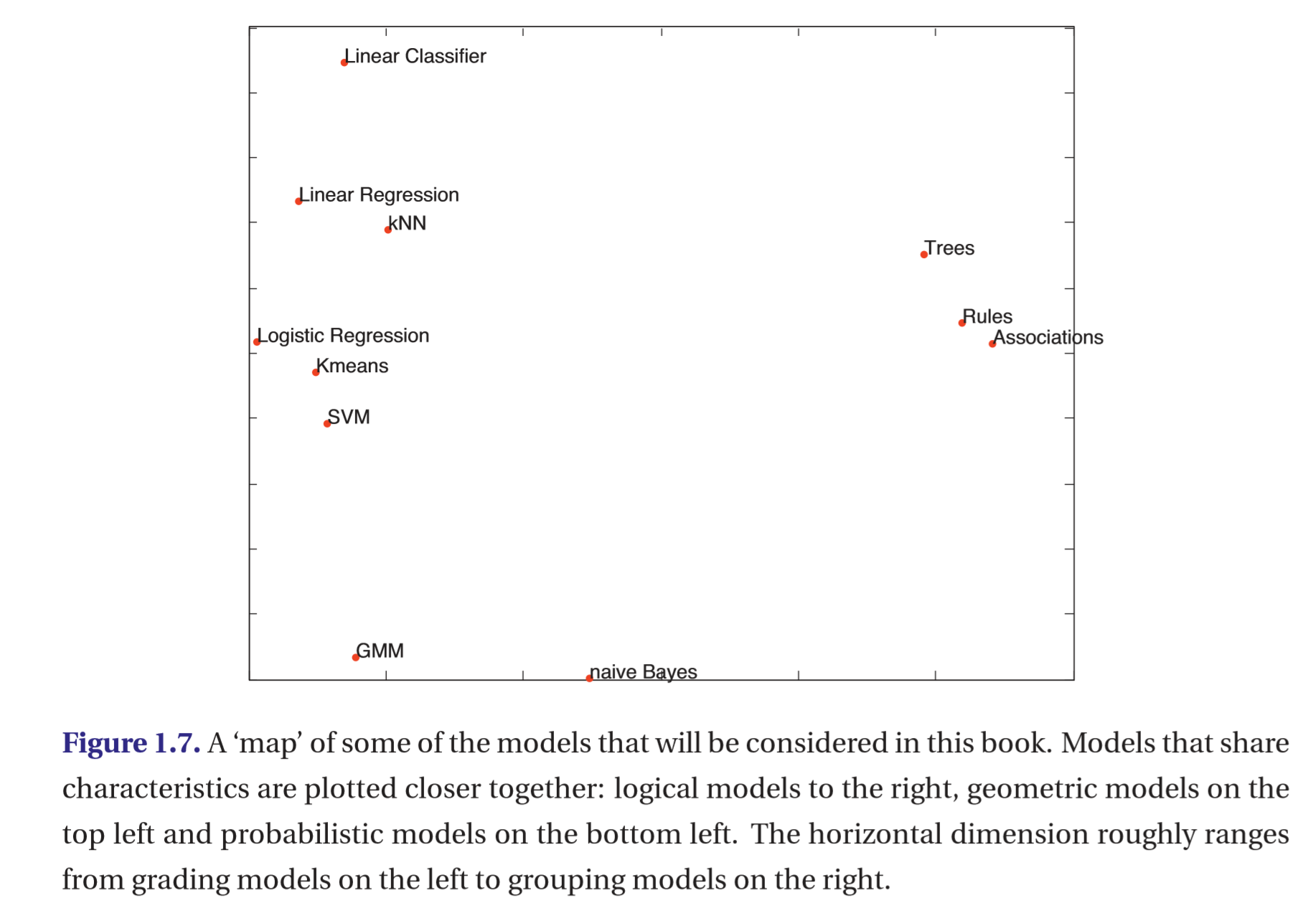
TIPOS DE MODELOS
Geométricos
Lógicos
probabilísticos

Slide 19
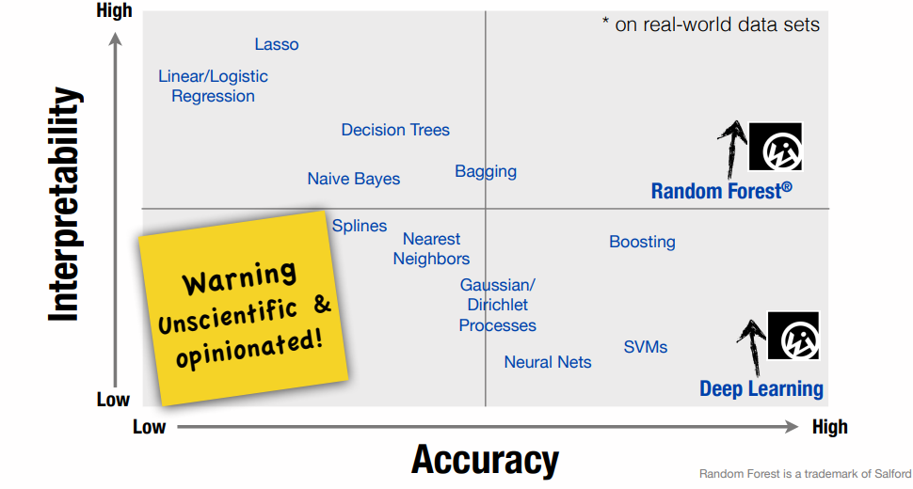

Slide 20
PROCEDIMIENTO GENERAL
Step 1: Statement of the problem. Most data modeling studies are performed in a particular application domain. Hence, domain-speciﬁc knowledge and experience are usually necessary in order to come up with a meaningful problem statement.
Step 2: Hypothesis formulation. The hypothesis in this step speciﬁes an unknown dependency, which is to be estimated from experimental data. At this step, a modeler usually speciﬁes a set of input and output variables for the unknown dependency and (if possible) a general form of this dependency.
Step 3: Data generation/experiment design. This step is concerned with how the data are generated. There are two distinct possibilities. The ﬁrst is when the data generation process is under control of a modeler—it is known as the designed experiment setting in statistics. The second is when the modeler cannot inﬂuence the data generation process—this is known as the observational setting,
Step 4: Data collection and preprocessing. This step has to do with both data collection and the subsequent preprocessing of data. Data preprocessing includes (at least) two common tasks: outlier detection/removal and data preprocessing (scaling)/encoding (dimensionality reduction )/feature selection.
Step 5: Model estimation. The main goal is to construct models for accurate prediction of future outputs from the (known) input values. The goal of predictive accuracy is also known as generalization capability.
Step 6: Interpretation of the model and drawing conclusions.

Slide 21
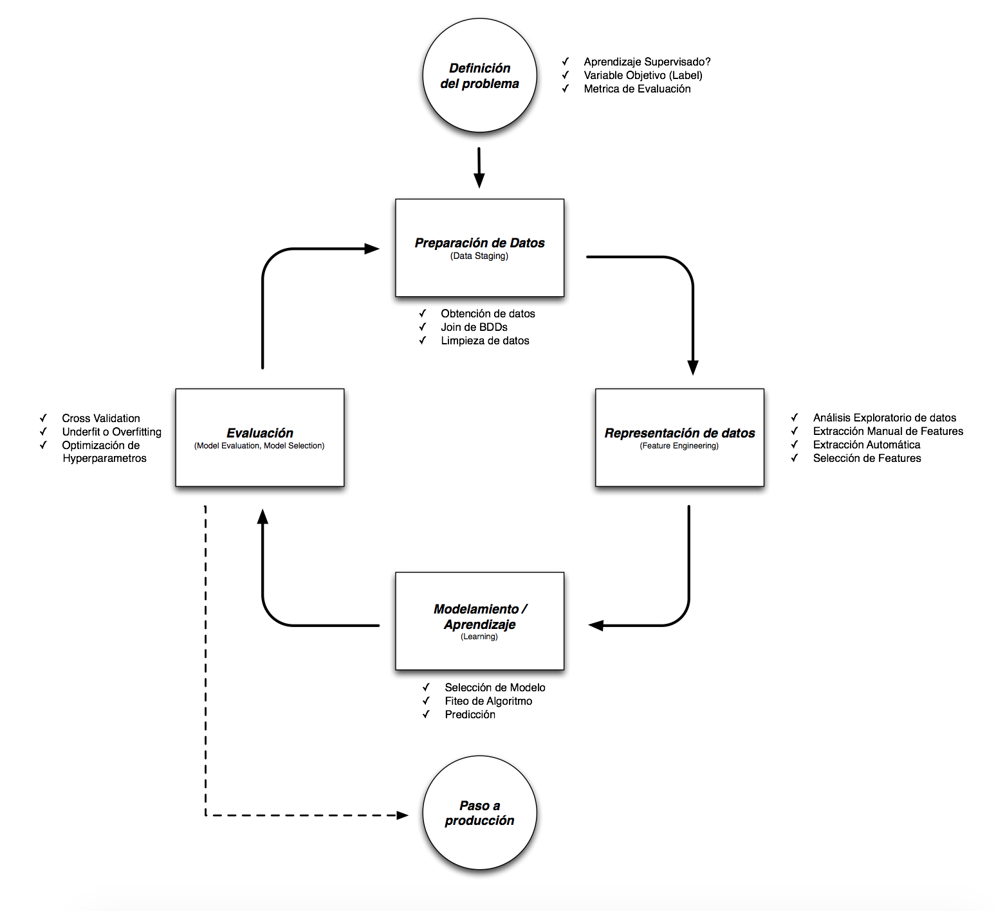
FLUJO DEL PROBLEMA

Slide 22

Science kit learning (scikit-learn)
Scikit-learn es la librería más usada de Machine Learning tradicional [Ver ranking de Github](https://github.com/showcases/machine-learning).
La librería incluye funcionalidades de:
Preprocesamiento de datos en sklearn.preprocessing
Algoritmos de Machine Learning en sklearn.linear_model, sklearn.svm, sklearn.ensemble, y muchos más.
Evaluación de modelos en sklearn.model_selection y sklearn.metrics

Slide 23
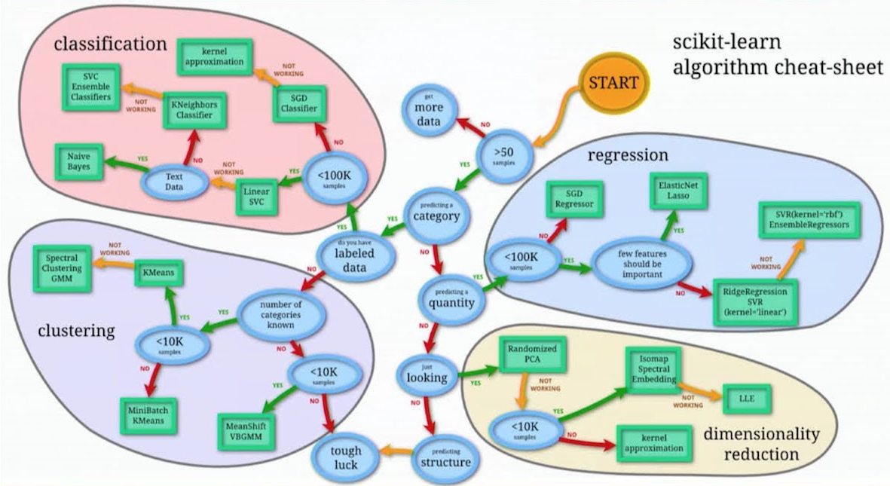
Science kit learning (scikit-learn)

Slide 24
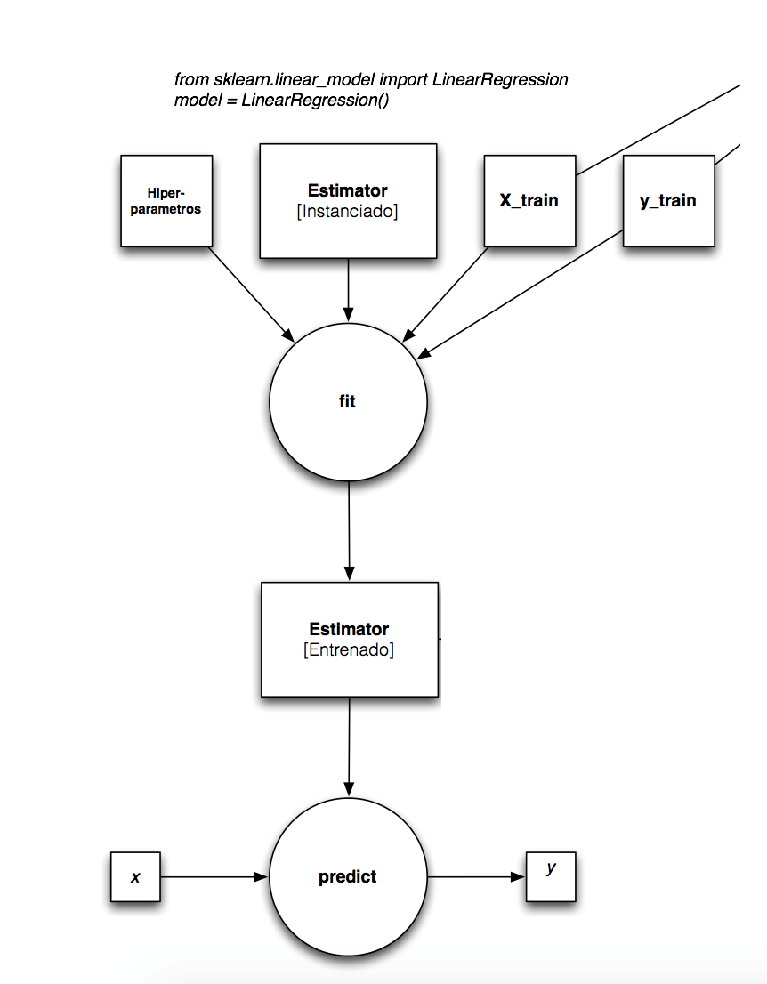
FLUJO DEL PROBLEMA

Slide 25
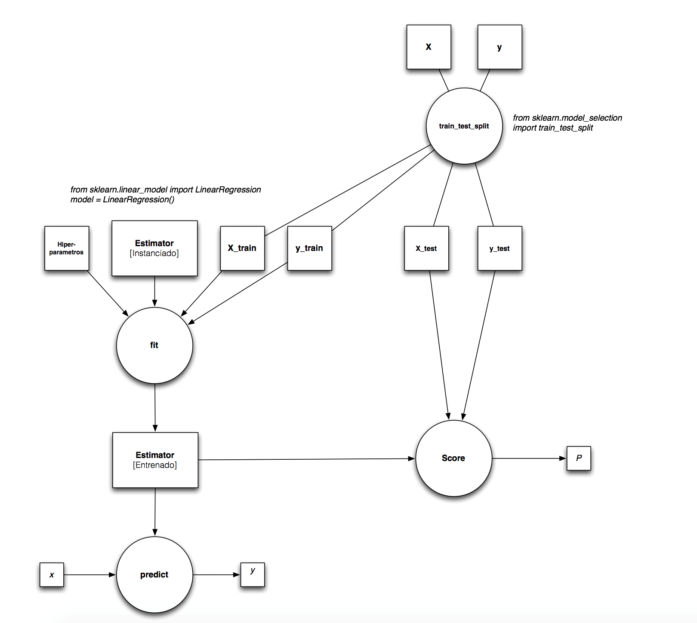
FLUJO DEL PROBLEMA

Slide 26
Science kit learning (scikit-learn)

Slide 27
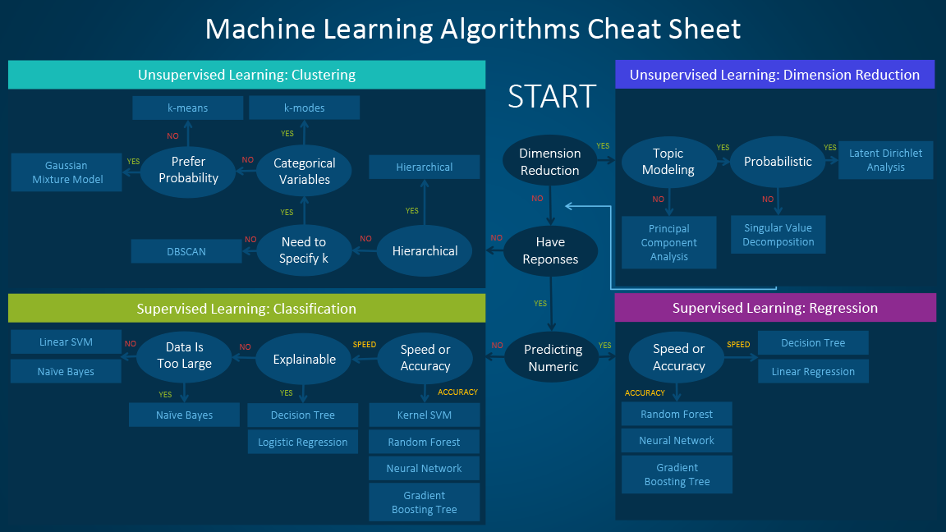

Slide 28
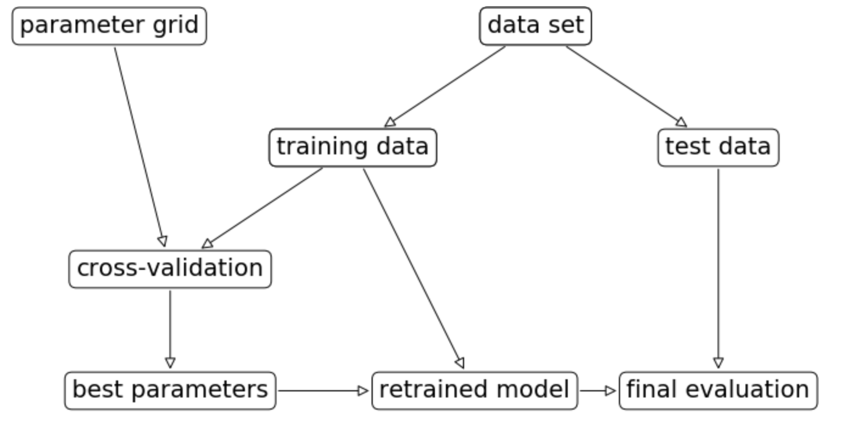
FLUJO DEL PROBLEMA

Slide 29
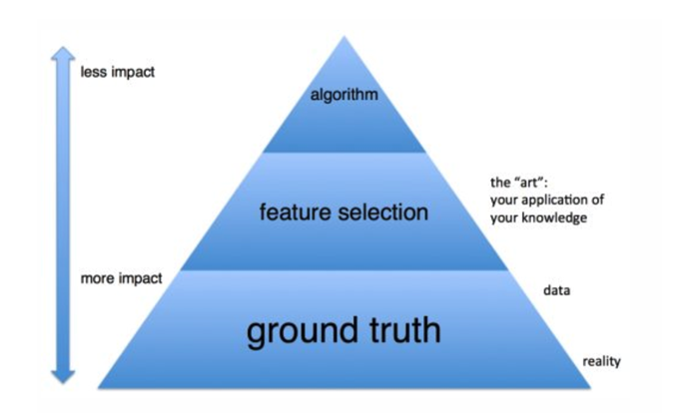
FLUJO DEL PROBLEMA
Piramide de Maslow para Machine Learning

Slide 30
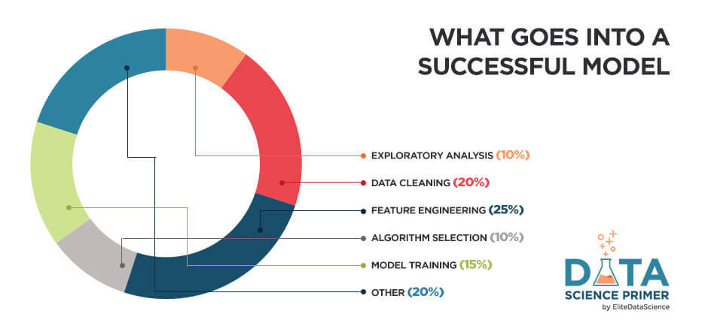
FLUJO DEL PROBLEMA

Slide 31
#1 - Exploratory Analysis Exploratory Analysis is the process of "getting to know" the dataset before you begin your modeling or other analyses. It consists of plotting key charts, displaying key statistics, and digging into the dataset—often into individual observations—to make sure you have everything you need to complete your project.

Slide 32
#2 - Data Cleaning In real-world problems, better data beats fancier algorithms every single time. Garbage in gets you garbage out. On the flipside, if you have a clean dataset, even simple algorithms can learn useful insights from it. While it's not the "sexiest" part of machine learning, proper data cleaning will make or break your project.

Slide 33
#3 - Feature Engineering Feature engineering is the process of creating new input features using your dataset. This is one of the best ways data scientists add value to the ML process and improve model results, as you're able to incorporate domain knowledge with feature engineering.

Slide 34
#4 - Algorithm Selection For business use cases of DS and ML, it's important to choose modern algorithms that are relevant and applicable to the problem. Generally speaking, the best place for beginners to start are tree ensembles (e.g. random forests), as they are very effective general-purpose algorithms. Don't jump into neural nets and deep learning right away, as those tend to have more niche use-cases.

Slide 35
#5 - Model Training Once you have the previous steps down, training a professional-level model is actually pretty straightforward and formulaic. There are few best practices, such as cross-validation and train/test splitting, that you'll want to incorporate to avoid overfitting your models.

Slide 36
PARÁMETROS DEL MODELO
A model parameter is a configuration variable that is internal to the model and whose value can be estimated from data.
They are required by the model when making predictions.
They values define the skill of the model on your problem.
They are estimated or learned from data.
They are often not set manually by the practitioner.
They are often saved as part of the learned model.
Parameters are key to machine learning algorithms. They are the part of the model that is learned from historical training data.
Some examples of model parameters include:
The weights in an artificial neural network.
The support vectors in a support vector machine.
The coefficients in a linear regression or logistic regression.

Slide 37
HIPER-PARÁMETROS DEL MODELO
In machine learning, a hyperparameter is a parameter whose value is set before the learning process begins. By contrast, the values of other parameters are derived via training.
Different model training algorithms require different hyperparameters, some simple algorithms (such as ordinary least squares regression) require none.
Given these hyperparameters, the training algorithm learns the parameters from the data.
For instance, LASSO is an algorithm that adds a regularization hyperparameter to ordinary least squares regression, which has to be set before estimating the parameters through the training algorithm.
The challenge with hyperparameters is that there are no magic number that works everywhere. The best numbers depend on each task and each dataset.
Hyperparameters can be divided into 2 categories:
Optimizer hyperparameters,
Model Specific hyperparameters

Slide 38
DEFINICIÓN MACHINE LEARNING
A machine learning model is the definition of a mathematical formula with a number of parameters that need to be learned from the data. That is the crux of machine learning: fitting a model to the data.
This is done through a process known as model training. In other words, by training a model with existing data, we are able to fit the model parameters.
However, there is another kind of parameters that cannot be directly learned from the regular training process. These parameters express “higher-level” properties of the model such as its complexity or how fast it should learn. They are called hyperparameters. Hyperparameters are usually fixed before the actual training process begins.
Define higher level concepts about the model such as complexity, or capacity to learn.
Cannot be learned directly from the data in the standard model training process and need to be predefined.
Can be decided by setting different values, training different models, and choosing the values that test better

Slide 39



#1: A skilled chef (human guidance)
#2: Fresh ingredients (clean, relevant data)
#3: Don't overcook it (avoid overfitting)
An overfit model has "memorized" the noise in the training set, instead of learning the true underlying patterns.

Slide 40
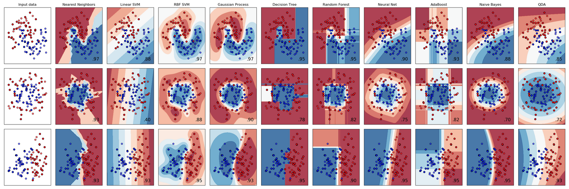
EJEMPLO

Slide 41
Qué sigue?...

